Slide 1
Support Vector Machines

Slide 2
Introduction
A linear method in a high-dimensional feature space nonlinearly related to input space
It does not involve any computation in that high-dimensional space
  By the use of kernels, all necessary computation are performed directly in input space

Slide 3
Data Classification
Two classes
  Estimate a function f:R^{N}→{±1}
  Using training data—that is, N-dimensional patterns x_{i} and class labels y_{i},
  (x₁,y₁),…,(x_{l}, y_{l}) ∈ R^{N}× {±1}
  To classify new examples (x,y)

Slide 4
Data Classification
A hyperplane which separates all data
  (w˙x) + b = 0
    w ∈ R^{N}, b ∈ R
Decision functions
  f(x) = sign((w˙x) + b)
  w and b : Need to know coefficients of a plane
  Many possible choices of w and b

Slide 5
Optimal Hyperplane
The hyperplan with the maximal margin of separation between the two classes

Slide 6
Optimal Hyperplane
The optimal hyperplane is orthogonal to the shortest line connecting the convex hulls of the two classes (dotted), and intersects it half way
There is a weight vector w and a threshold b such that y_{i}((w ˙ x_{i}) + b) > 0
Rescaling w and b such that the point(s) closest to the hyperplane satisfy |(w ˙ x_{i}) + b| = 1, we obtain a form (w,b) of the hyperplane with y_{i}((w˙x_{i}) + b) ≥ 1
Note that the margin, measured perpendicularly to the hyperplane, equals 2/|| w ||
To maximize the margin, we thus have to minimize |w| subject to y_{i}((w˙x_{i}) + b) ≥ 1

Slide 7
Optimal Hyperplane
Distance between w˙x + b = 1 and -1:
  2 /|| w || = 2/(w^{T}w)^{1/2}
max 2 /|| w ||≡ min w^{T}w/2

Slide 8
Optimal Hyperplane
The optimal hyperplane can be uniquely constructed by solving a constrained quadratic optimization problem whose solution w has an expansion
  x_{i}: training patterns that lie on the margin (support vectors)

Slide 9
Feature Spaces
Data may not be linear separable
Non-separable case: allow training errors
  ξ_{i} > 1, x_{i} not on the correct side of the separating plane
  C: large penalty parameter, most ξ_{i} are zero

Slide 10
Feature Spaces
Nonlinear case: linear separable in other spaces ?
  Nonlinearly map the data into a (higher) dimensional (maybe infinite) feature space
  Perform linear algorithm in the feature space F

Slide 11
Feature Spaces

Slide 12
Feature Spaces
w: a vector in a high dimensional space → maybe infinite variables
The dual problem

Slide 13
Feature Spaces
Dot product in feature space
  if F is high-dimensional, the right-hand side will be very expensive to compute
  In some cases, however, there is a simple kernel k that can be evaluated efficiently

Slide 14
Feature Spaces
Polynomial kernel
  k(x,y)=(x˙y)^{d}
d=2

Slide 15
Kernel Trick
Kernel:
No need to explicitly know Φ(x)
  Polynomial kernel, d=2
    k(x,y)=(x˙y)²
    Let

Slide 16
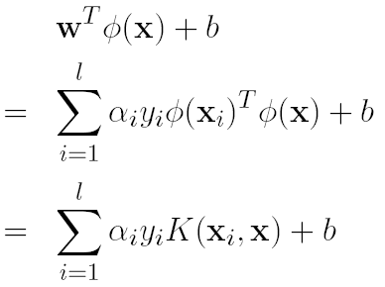
Kernel Trick
At optimum
Decision function
No need to have w

Slide 17
SVMs
Decision function in feature space

Slide 18
SVMs
Decision function
  > 0: 1st class (+), < 0: 2nd class (-)
  Only Φ(x_{i}) of α_{i} > 0 used
  α_{i} > 0 → support vectors
    There is one α_{i} for each training example
    Each α_{i} determines how much each training example influences the SVM function
    Most of the training examples do not affect the SVM function, so most of the α_{i} are 0

Slide 20

Multi-class Classification
k classes
One-against-all: Train k binary SVMs
    1st class vs. (2 ~ k)th class
    2nd class vs. (1, 3 ~ k)th class
    ...
  k decision functions
Select the index with the largest

Slide 21
Multi-class Classification
One-against-one: train k(k - 1)/2 binary SVMs
  (1, 2), (1, 3),…, (1, k), (2, 3), (2, 4),…, (k-1, k)
Select the one with the largest vote

Slide 22
Example: Text-Categorization
Assign new items to one or more of a set of predefined categories on the basis of their textual content
Classifier
  In the case of text classification, the attributes are words in the document and the classes are the categories of interest

Slide 23
Example: Text-Categorization
Example classifiers
  if (interest AND rate) OR (quarterly), then confidence (“interest” category) = 0.9
  confidence (“interest” category) = 0.3*interest + 0.4*rate + 0.7*quarterly
SVM
  Linear SVM
  Learn the vector of feature weights,

Slide 24
Example: Text-Categorization
Each document is represented as a vector of words
  Feature weight
    IR: tf*idf
    Text classification: binary
  Feature selection
    Remove features based on overall frequency counts
    Select a small number of features based on their fit to categories (mutual information)

Slide 25
Example: Text-Categorization
Experiment data
  Reuters
    12,902 stories
      Training: 75% (9,603 stories)
      Test: 25% (3,299 stories)
    118 categories
      When testing, one story can be assigned to more than one category
  Eliminating words that appear in only one document and then selecting the 300 words with highest mutual information with each category

Slide 26
Example: Text-Categorization
SVM
  One classifier for each category
  Compute a score for a new document and a category ( )
  If the score of the new document exceeding a learned threshold, the document is said to belong to the category

Slide 27
Example: Text-Categorization

Slide 28
Example: Text-Categorization
Performance of category “grain”

Slide 29
Example: Face Detection
Given as input an arbitrary image, determine whether there are any human faces in the image, and if there are, return an encoding of their location
Applications
  Face recognition, human-computer interfaces, surveillance systems, and census systems
  tumor anomalies in MRI scans and structural defects in manufactured parts

Slide 30
Example: Face Detection
It is a difficult task
  Significant pattern variations
    Facial appearance, expression, presence or absence of common structural features such as glasses or a moustache, and light-source distribution
Use a classification procedure that determines whether a given local image pattern is a face

Slide 31
Example: Face Detection
Divide the original image into overlapping subimages and classifying them using an SVM to determine the appropriate class—face or nonface
Train on a database of face and nonface 19x19 pixel patterns
  Second-degree homogeneous polynomial kernel function and an upper bound C = 200

Slide 32
Non-faces
Faces

Slide 33
Example: Face Detection
Preprocessing
  Masking
    A binary pixel mask removes some pixels close to the window-pattern boundary, allowing a reduction in the dimensionality of the input space from 19 x 19 = 361 to 283
  Illumination gradient correction
    The process subtracts a best-fit brightness plane from the unmasked window pixel values, allowing reduction of light and heavy shadows
  Histogram equalization

Slide 34
Example: Face Detection
Bootstrapping training
  Once the process obtains a decision surface through training, it uses the runtime system over images that do not contain faces, storing misclassifications so that they can be used as negative examples in subsequent training phases
    The nonobject class is broader and richer, and therefore needs more examples to get an accurate definition that separates it from the object class

Slide 35
Example: Face Detection
Detection
  Rescale the input image several times
  Cut 19x19 window patterns out of the scaled image
  Preprocess the window using masking, light correction and histogram equalization
  Classify the pattern using the SVM
  If the class corresponds to a face, draw a rectangle around the face in the output image

Slide 36
Example: Face Detection

Slide 37
Example: Face Detection
Test data
  Set A
    313 high quality images with the same number of faces
    4,669,960 pattern windows
  Set B
    23 images of mixed quality, with a total of 155 faces
    5,383,682 pattern windows

Slide 38
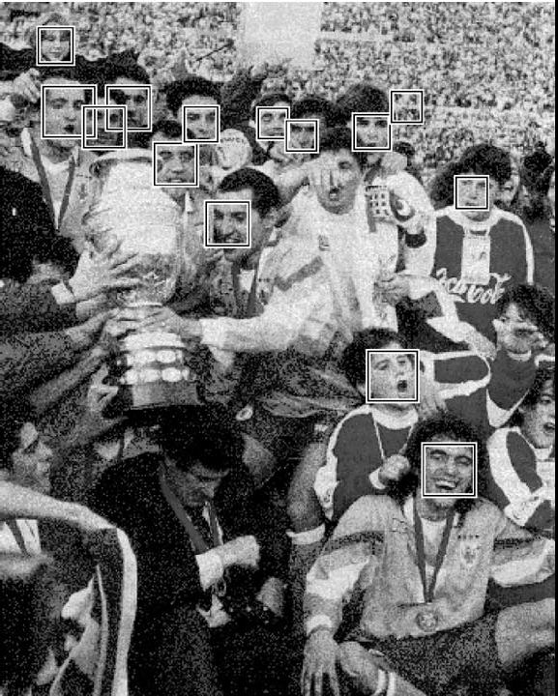
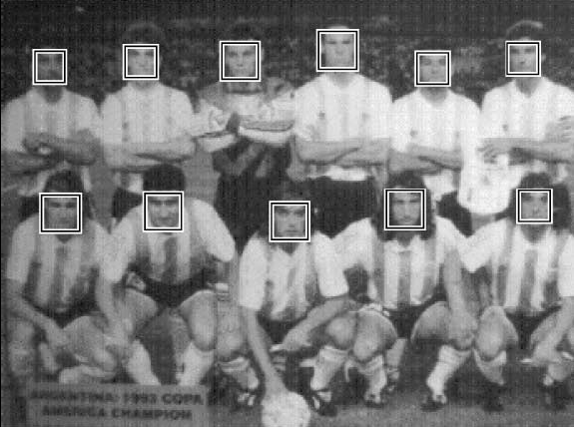
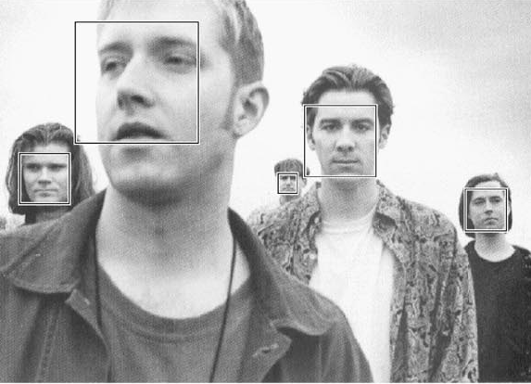
Example: Face Detection
Spends approximately 6 seconds (SparcStation 20) on a 320x240 pixels gray-level image

Slide 39
Example: Face Detection
Extension to a real-time system
  Port the C code developed on the Sun environment to a Windows NT Pentium 200-MHz computer and added a Matrox RGB frame grabber and a Hitachi three-chip color camera
  Collect several color images with faces, from which extract areas with skin and non-skin pixels

Slide 40
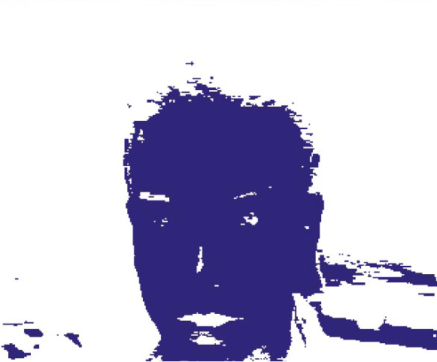
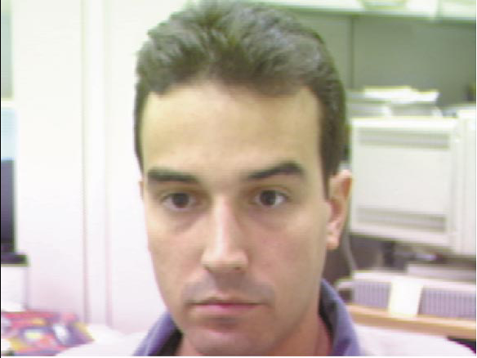
Example: Face Detection
  Train a SVM classifier using the skin and non-skin data. The input variables are normalized green and red values—g/(r+g+b) and r/(r+g+b)

Slide 41
Example: Face Detection
  Code a very primitive motion detector based on thresholded frame differencing to identify areas of movement and use them as the focus of attention
  Hierarchical system
    Motion-detection
    SVM skin-detection
    Face/non-face SVM classifier over the gray-level version of the candidate locations
  The whole system achieves rates of 4 to 5 frames per second

Slide 42
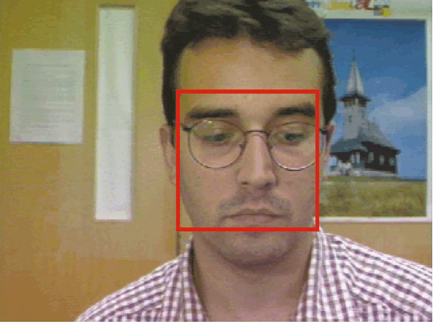
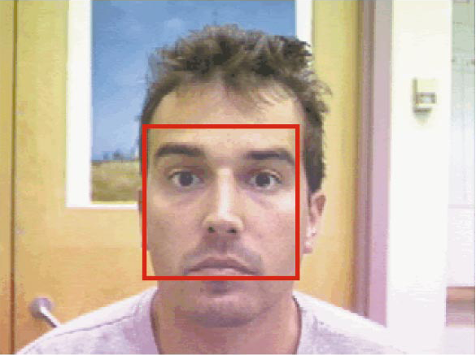
Example: Face Detection
Face detection on the PC-based Color Real-Time system

Slide 43
A Practical Guide to SVM
Users who are not familiar with SVM often get unsatisfactory results at first
A “cookbook” approach which usually gives reasonable results
Common used kernels

Slide 44
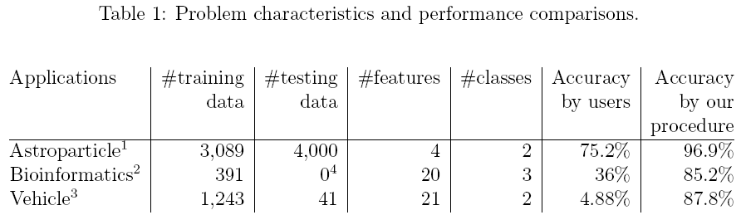
Real-World Examples

Slide 45
Beginner’s Procedure
Transform data to the format of an SVM software
Randomly try a few kernels and parameters
Test

Slide 46
The Proposed Procedure
Transform data to the format of an SVM software
Conduct simple scaling on the data
Consider the RBF kernel
Use cross-validation to find the best parameter C and γ
Use the best parameter C and γ to train the whole training set
Test

Slide 47
Data Preprocessing
Convert categorical attributes into numeric data
  Using m numbers to represent an m-category attribute
  Only one of the m numbers is one, and others are zero
    A three-category attribute {red, green, blue} can be represented as (0,0,1), (0,1,0), and (1,0,0)
  if the number of values in an attribute is not too many, this coding might be more stable than using a single number to represent a categorical attribute

Slide 48
Data Preprocessing
Scaling
  Avoid attributes in greater numeric ranges dominate those in smaller numeric ranges
  Avoid numerical difficulties during the calculation
  Linearly scaling each attribute to the range [−1, +1] or [0, 1]
  Use the same method to scale testing data before testing

Slide 49
Data Preprocessing
  Example
    Scale the first attribute of training data from
    [-10,+10] to [-1, +1]
    If the first attribute of testing data is lying in the range [-11, +8], we must scale the testing data to
    [-1.1, +0.8]

Slide 50
Model Selection
Use a kernel to determine the penalty parameter C and kernel parameters (γ,r,d)
In general RBF is a reasonable first choice
  Nonlinearly maps samples into a higher dimensional space
  Has fewer number of hyperparameters
  Has less numerical difficulties
    0 < K_{ij} ≤ 1

Slide 51
Cross-Validation
Identify good (C,γ) so that the classifier can accurately predict unknown data
v-fold cross-validation
  First divide the training set into v subsets of equal size
  Sequentially one subset is tested using the classifier trained on the remaining v − 1 subsets

Slide 52
Cross-Validation
Prevent the overfitting problem

Slide 53
Cross-Validation

Slide 54
Grid-Search
Basically pairs of (C,γ) are tried and the one with the best cross-validation accuracy is picked
Trying exponentially growing sequences of C and γ is a practical method to identify good parameters
  C = 2⁻⁵, 2⁻³, . . . , 2¹⁵; γ = 2⁻¹⁵, 2⁻¹³, . . . , 2³

Slide 55
Grid-Search
Why grid-search?
  Feel safe
  The computational time is not much more than that by advanced methods since there are only two parameters
  The grid-search can be easily parallelized
Use a coarse grid first. After identifying a “better” region on the grid, a finer grid search on that region can be conducted

Slide 56
Grid-Search
Best (C,γ) is (2³, 2⁻⁵), 77.5%

Slide 57
Grid-Search
Best (C,γ) is (2^{3.25}, 2^{−5.25}), 77.6%

Slide 58
Grid-Search
After the best (C,γ) is found, the whole training set is trained again to generate the final classifier
For very large data sets
  Randomly choose a subset of the data set
  Conduct grid-search on them
  Then do a better-region-only grid-search on the complete data set

Slide 59
Discussion
In some situations, the procedure is not good enough, so other techniques such as feature selection may be needed
The procedure works well for data which do not have many features
If there are thousands of attributes, there may be a need to choose a subset of them before giving the data to SVM

Slide 60
Example
Use LIBSVM
Astroparticle Physics
  Original sets with default parameters
    $./svm-train train.1
    $./svm-predict test.1 train.1.model test.1.predict
    → Accuracy = 66.925%
  Scaled sets with default parameters
    $./svm-scale -l -1 -u 1 -s range1 train.1 > train.1.scale
    $./svm-scale -r range1 test.1 > test.1.scale
    $./svm-train train.1.scale
    $./svm-predict test.1.scale train.1.scale.model test.1.predict
    →Accuracy = 96.15%

Slide 61
Example
  Scaled sets with parameter selection
    $python grid.py train.1.scale
    · · ·
    2.0 2.0 96.8922
    (Best C=2.0, γ =2.0 with five-fold cross-validation rate=96.8922%)
    $./svm-train -c 2 -g 2 train.1.scale
    $./svm-predict test.1.scale train.1.scale.model test.1.predict
    → Accuracy = 96.875%

Slide 62
Example
Bioinformatics
  Original sets with default parameters
    $./svm-train -v 5 train.2
    →Cross Validation Accuracy = 56.5217%
  Scaled sets with default parameters
    $./svm-scale -l -1 -u 1 train.2 > train.2.scale
    $./svm-train -v 5 train.2.scale
    → Cross Validation Accuracy = 78.5166%

Slide 63
Example
  Scaled sets with parameter selection
    $python grid.py train.2.scale
    · · ·
    2.0 0.5 85.1662
    → Cross Validation Accuracy = 85.1662%
    (Best C=2.0, =0.5 with five fold cross-validation rate=85.1662%)

